Slide 1
Group 2
Courtney, Lewis, Tom, and Heather

Slide 2
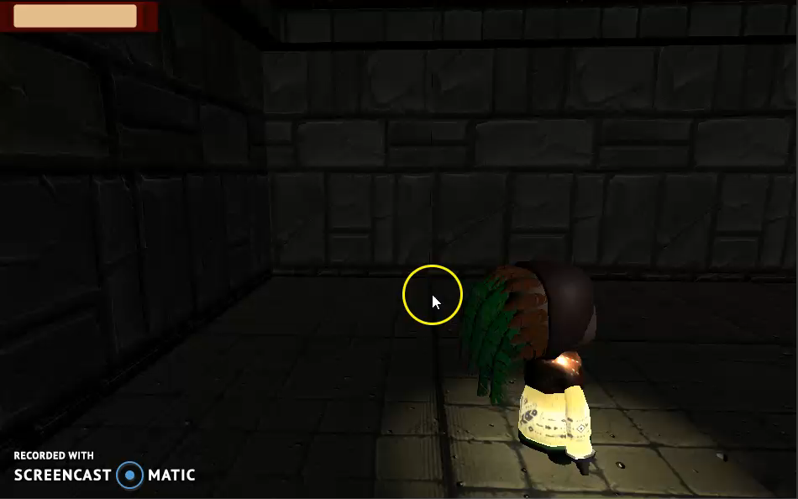
Game Footage

Slide 3
ACHIEVING FLOW
Concrete goals with manageable rules
Goals that fit player capabilities.
Clear and timely feedback.
Eliminate distractions
Collectables

Slide 4
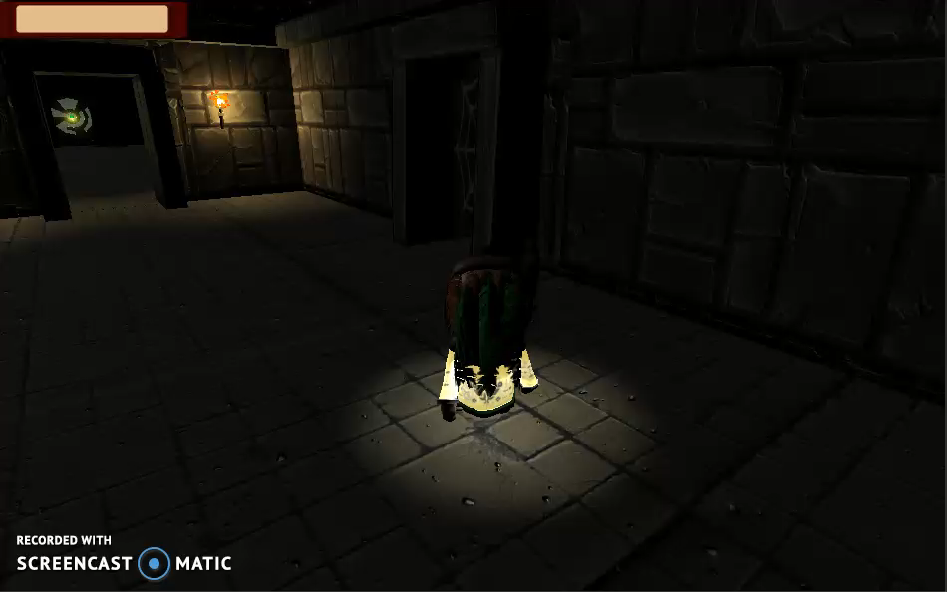
Mechanics
Managing the Light resource
Light Puzzle

Slide 5
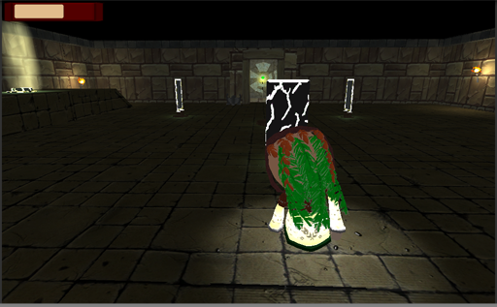
Goals
Colour affordances
Flashing lights/movement
Level design

Slide 6
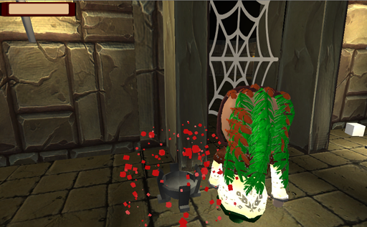
Feedback
Sounds
Visuals
Aesthetics

Slide 7
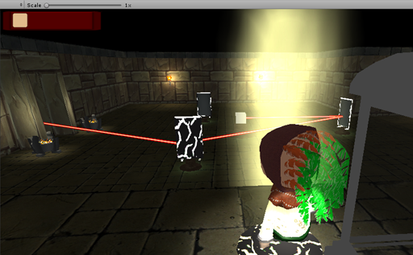
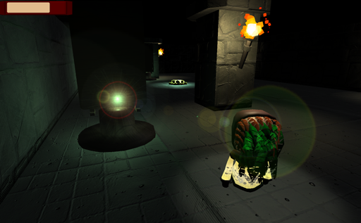
UI
Light resource
Objective
Pop up prompts

Slide 8
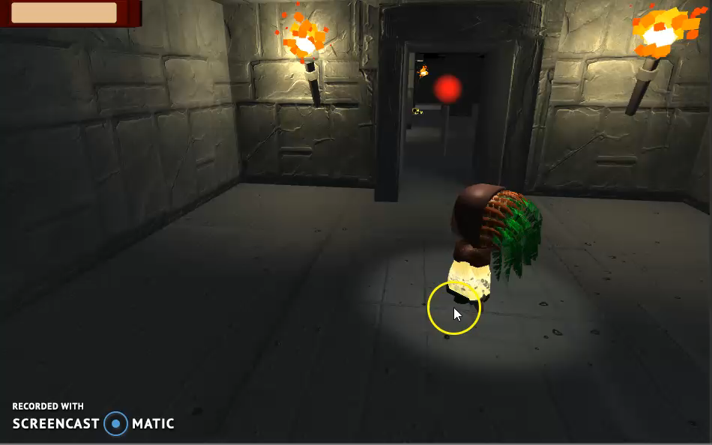
Level Design
Needs to make better use of sightlines to direct players
Very linear path
Needs props to fill space

Slide 9
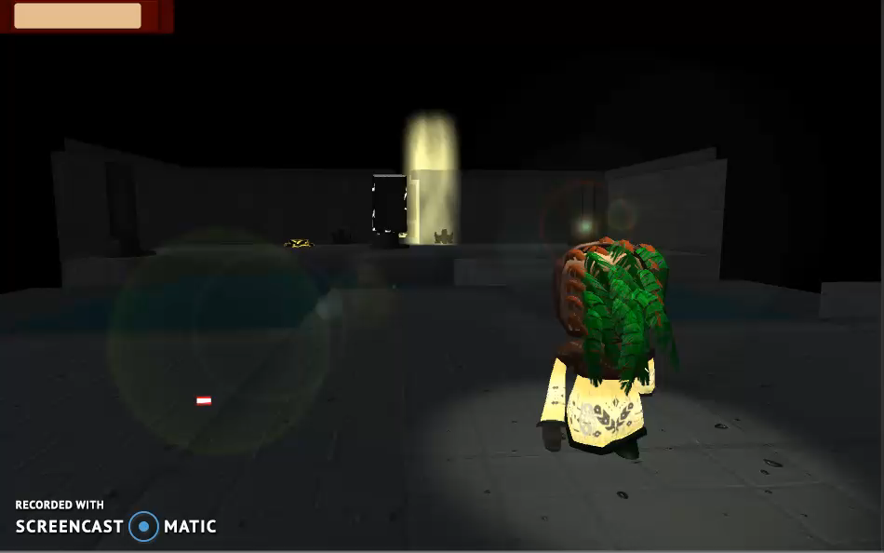
Level Design
-Medium/Small spaces
-Puzzle elements must all fit on screen together
More verticality and branching paths

Slide 10
Bug fixes
Camera
Inventory system
Animation

Slide 11
Next Steps
Playtest.
Fix everything revealed by playtesting.
Polish.
Lighting.
Menu/End screen.

Slide 12
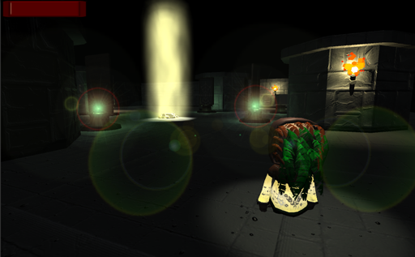
Any questions?

